Slide 1
Causes and Consequences of In-Migration in Shankharapur Municipality of Kathmandu, Nepal
A Thesis Defense Presentation
Submitted By: Kristal Suwal (Exam Roll No: 2030013)
Supervisor: Mr. Tirtha Raj Timsina, Lecturer
Institution: Bhaktapur Multiple Campus, Tribhuvan University | October 2026

Slide 2
1. Introduction & Background
Migration is a key driver of population change alongside fertility and mortality.
• Increasing shift of population from rural/hilly areas toward urban and sub-urban centers.
• Serves as a mechanism balancing population distribution with economic opportunities and social services.
• Post-2015 earthquake reconstruction accelerated population movement to sub-urban place like Shankharapur.
Focus Area: Shankharapur Ward 9
• Geographic Location: Shankharapur Municipality Ward No. 9 (Sankhu), located in eastern region of Kathmandu Valley.
• Sub-Urban Transition: Rapidly developing area experiencing a steady inflow of in-migrants.
• Research Focus: Investigating why people relocate here and examining the resulting socio-economic impacts.
• Study Scale: Complete enumeration covering 89 migrant households (345 individuals) in the ward.

Slide 3
2. Objectives of the Study
To examine the primary causes for in-migration into the study area.
To assess the existing socio-economic and demographic nature and characteristics of migrant households.
To explore the consequences of in-migration at the place of destination.

Slide 4
3. Limitations
Geographical Scope:
Confined specifically to Shankharapur Ward 9 (Sankhu); findings reflect localized sub-urban movement and cannot be broadly generalized across all municipal regions.
Time & Resource Constraints:
Conducted within a fixed academic timeframe and resource budget, limiting longitudinal tracking and multi-ward institutional data collection.
Focus on Settled Households:
Focused on registered resident migrant households (89 households); short-term, floating, or seasonal laborers may not be fully captured.
Self-Reported Survey Data:
Relies on household head disclosures, which are subject to individual perception and potential hesitation to share sensitive income or financial details.

Slide 5
4. Research Methodology
Study Area & Selection
• Location: Shankharapur Municipality Ward No. 9 (Sankhu), Kathmandu.
• Selection: Purposive selection based on rapid sub-urban growth and high migrant inflow.
Sampling & Population
• Complete Enumeration: Total of 89 migrant households surveyed.
• Total Migrants: 345 individuals (181 males, 164 females).
• Sample Coverage: 100% census of identified migrant households.
Data Collection Tools
• Primary Data: Structured household questionnaire survey schedule.
• Key Indicators: Socio-economic profile, causes, income pre/post, facilities.
• Secondary Data: Ward records, Municipal reports, Census 2021.
Data Processing & Analysis
• Software Tools: Microsoft Excel/SPSS for processing.
• Analytical Methods: Tabulation, percentage distributions, classifications.
• Comparative Approach: Pre-migration vs. Post-migration metrics.

Slide 6
5. Data Analysis and Presentation
Total migrants: 345 people, 89 households
Sex ratio: 181 males and 164 females
Literacy rate: male 93.7%, female 66.9%
Family size: 3.88 persons per household
Ethnic Composition of Households
Ethnicity | Households | Percentage
Chhetri | 32 | 36.0%
Brahmin | 28 | 31.5%
Janajati | 23 | 25.8%
Dalit | 6 | 6.7%

Slide 7
5. Data Analysis and Presentation
Size of Land Holdings by migrant household
Size of land holdings | No. of Households | Percentage
Ropani | 16 | 17.9%
Aana | 62 | 69.7%
Paisa | 0 | 0%
Dam | 0 | 0%
Others | 11 | 12.4%

Slide 8
5. Data Analysis and Presentation
Age Structure & Dependency Ratio
Dependency Metric | Ratio Value | Interpretation
Child Dependency Ratio | 16.67 | 0-14 Years
Old Age Dependency Ratio | 8.33 | 65+ Years
Total Age Dependency Ratio | 25.00 | Low burden
Economically Active (15-64) | 74.8% | High workforce

Slide 9
5. Data Analysis and Presentation
Marital Status of Migrant population

Slide 10
6. Causes of In-Migration
Place of Origin of migrants households

Slide 11
6. Causes of In-Migration
Primary Reasons for Leaving Origin
• Limited Infrastructure: 34.83%
• Limited Job Opportunities: 26.97%
• Limited Market Access: 20.22%
• Limited Arable Land: 7.87%
• Government Job Posting: 5.62%
• Victim of Conflict: 4.49%
Origin & Decision-Maker
Decision Making Responsibility:
- Near Relatives: 28.09% (25 HHs) — Key decision influencer.
- Spouse / Children: 23.60% (21 HHs) — Family-mediated decisions.
- Individual Self: 16.85% (15 HHs) | Friends: 16.85% (15 HHs).

Slide 12
OUTCOMES
7. Consequences & Comparative Analysis
Monthly Income Shift (Previous vs After Migration)
Income Bracket (Rs.) | Origin (%) | Destination (%)
Below 20,000 | 34.8% | 12.4% (↓ Decreased)
20,000 - 39,999 | 55.1% | 65.2%
40,000 and above | 10.1% | 22.5% (↑ Doubled)
Total Households | 100.0% | 100.0% (89 HHs)
Satisfaction at current place of residence
Satisfaction | No. of Households | Percentage (%)
Yes | 79 | 88.8%
No | 8 | 9.0%
Same as before | 2 | 2.2%
Total Households | 89 | 100.0%

Slide 13
OUTCOMES
7. Consequences & Comparative Analysis
Distribution of Migrant Households by Changes in Selected Aspects)

Slide 14
OUTCOMES
7. Consequences & Comparative Analysis
Challenges & Problems at Destination
• Inadequate Development Funding: 39.3%
(35 HHs (Major infrastructure gap))
• Insufficient Health Facilities: 19.1%
(17 HHs)
• Bad Social Environment: 18.0%
(16 HHs)
• Lack of Employment Opportunities: 15.7%
(14 HHs)
• Inadequate Drinking Water Supply: 7.9%
(7 HHs)

Slide 15
SUMMARY
9. Conclusion & Recommendations
Main Conclusions
• In-migration in Shankharapur Ward 9 is primarily driven by economic and infrastructural push factors (lack of roads, jobs, and market access at origin).
• Migration is long-distance and family-mediated, with relatives playing a major role in destination choice.
• Migration outcomes are overall favorable: household incomes increased significantly, education access improved, and 88.8% report satisfaction.
• However, local infrastructure (development funding, health facilities) is struggling to keep pace with rapid inflow.

Slide 16
SUMMARY
9. Conclusion & Recommendations
Recommendations
• Strengthen Infrastructure Funding:
Allocate higher development budgets to Ward 9 to upgrade roads and basic utilities.
• Expand Healthcare Facilities:
Address the 19.1% health facility deficit by enhancing local primary health posts.
• Promote Local Job Creation:
Develop local enterprise and vocational training to create municipal employment opportunities.
• Targeted Female Literacy:
Conduct adult education programs to address the gender literacy gap (Female 66.9% vs Male 93.7%).
• Municipal Administrative Recordkeeping:
Formally clarify and record land-ownership criteria required for migrant status certification.

Slide 17
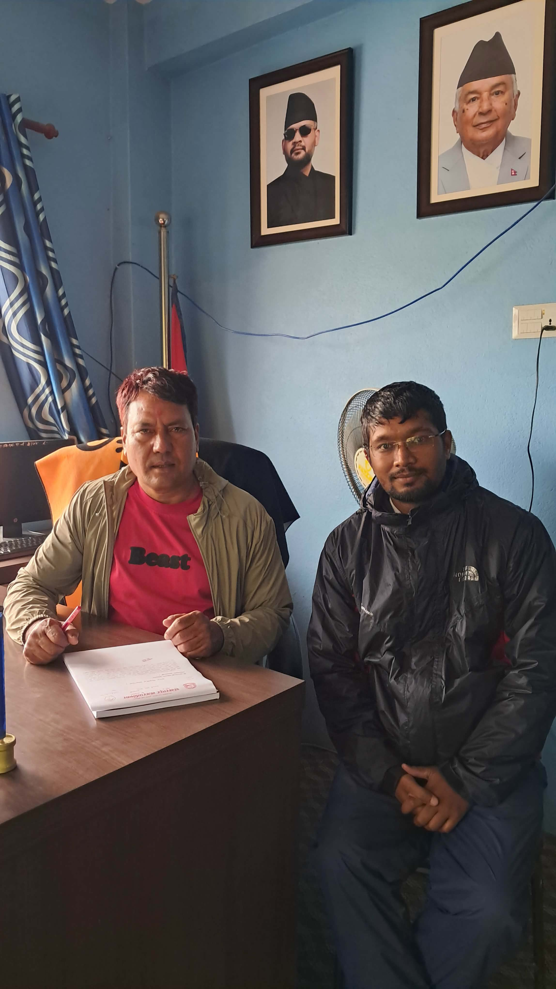
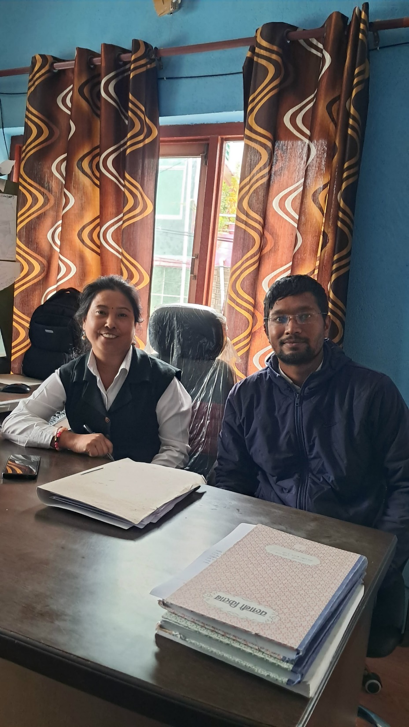

Slide 18
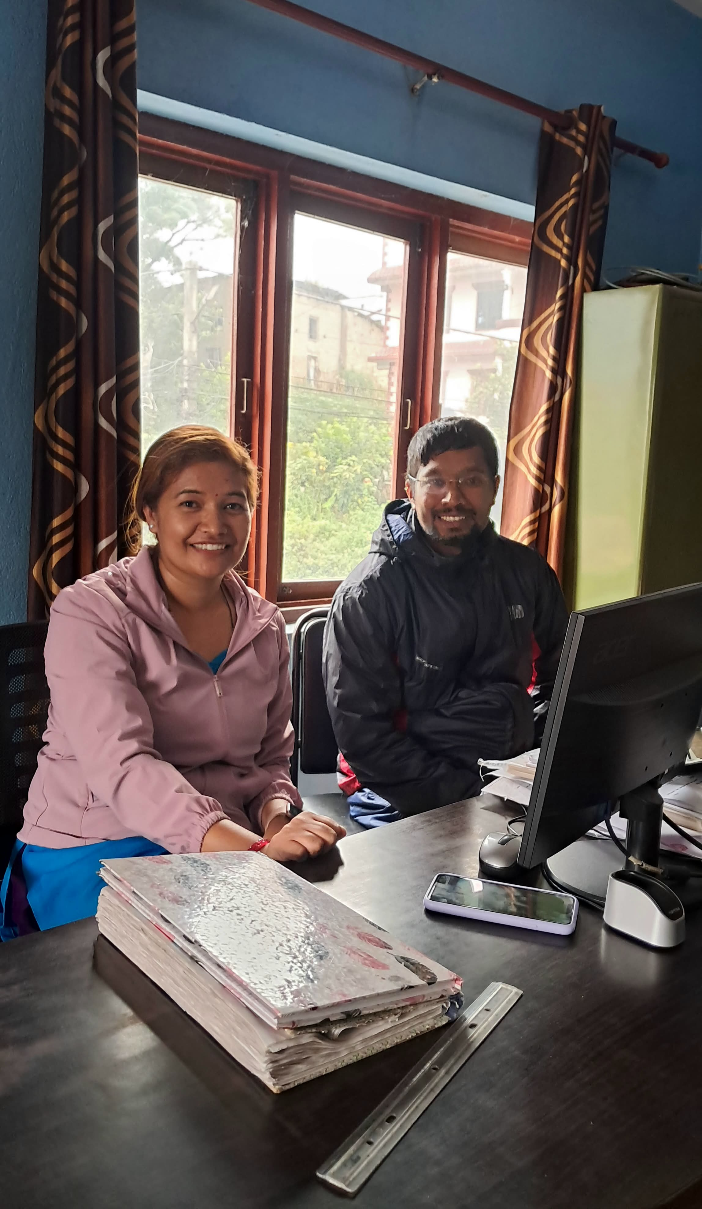

Slide 19
Thank you!

